Slide 1


Assurance Methods for Clinical Trials: practical tools and new developments
James Salsbury¹, Jeremy Oakley¹, Steven Julious², Lisa Hampson³
¹School of Mathematics and Statistics, The University of Sheffield
²School of Health and Related Research, The University of Sheffield
³Novartis Pharma AG, Basel, Switzerland

Slide 2
Introduction
Overview of power/assurance
An example of elicitation/assurance
My current area of research
Slide 2

Slide 3
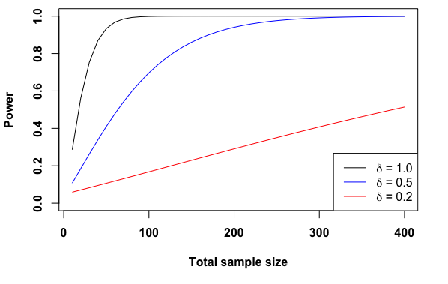
What is assurance?
What is power?
Slide 3

Slide 4
What is assurance?
What is power?
“The probability of detecting a difference between groups given a difference exists”
However, this is conditional. Can we do better?
By eliciting distributions for the parameters of interest then this probability is now unconditional
Trial can still be analysed using frequentist methods
Slide 3

Slide 5

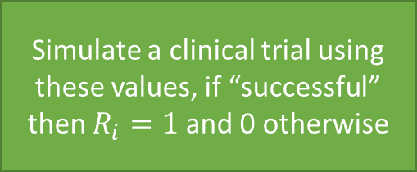
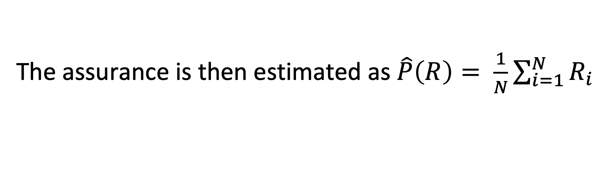
How do you calculate assurance?
Elicit distributions for the parameters of interest
Sample values from these distributions
The assurance is then estimated as $\hat{P}\left(R\right)= \frac{1}{N}\sum_{i=1}^{N}{R_{i}}$
Slide 4

Slide 6
What are the barriers of using assurance in practice?
Eliciting distributions for the parameters of interest: it can be difficult to convey beliefs/uncertainty
Resources: time and/or money
What work has been done in this area?
O’Hagan et al (2005) consider normal and binomial outcomes
Ren and Oakley (2014) consider time-to-event outcomes
Alhussain and Oakley (2020) consider uncertainty about variances
SHeffield ELicitation Framework (SHELF) is a tool used for eliciting a probability distribution from an expert or a group of experts
Slide 5

Slide 7


Probability of Success (PoS) at Novartis
Information added
How
PoS at end of Ph2
1
Step 1 estimate
7 program characteristics
Predictive model fitted to industry data
END OF PH2
Step 2 estimate
2
Pivotal / Phase 3 risks
Bayesian analysis: prob of meeting TPP
Probability of “Success”
Incremental PoS adjustment
3
Step 3 estimate
Beyond Pivotal / Ph 3 risks
Adjustment algorithm
calibrated by experts
Exceptions only
Final estimate
4
Unaccounted risks / data
Subjective adjustment
TPP
(pivotal)
60%
95%
70%
Hampson LV, Bornkamp B, Holzhauer B et al. Pharmaceutical Statistics 2022; 21:439
Holzhauer B, Hampson LV, Gosling JP et al. Pharmaceutical Statistics 2022. In press.
Within a Phase
60% * 95% = 57%
(potential gap)
Probability of Approval
Probability of Success
60% * 95% * 70% = 40%
Slide 6
7

Slide 8
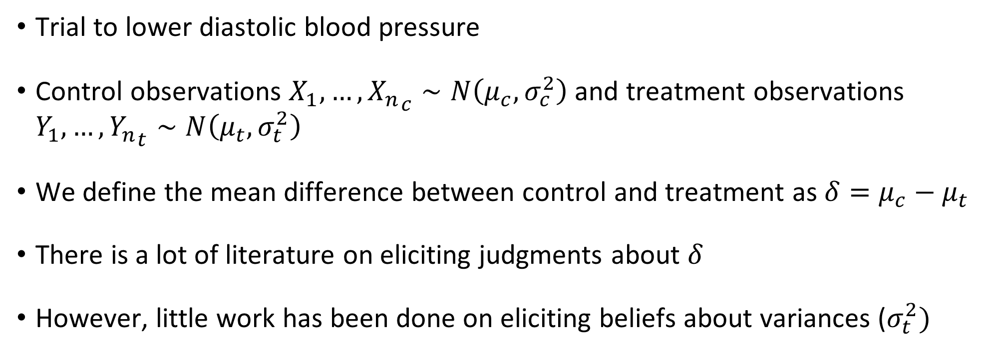
Trial with Normal endpoints
Trial to lower diastolic blood pressure
Control observations $X_{1}, …, {X_{n}}_{c}∼N\left(μ_{c}, σ_{c}^{2}\right)$ and treatment observations $Y_{1}, …, {Y_{n}}_{t}∼N\left(μ_{t}, σ_{t}^{2}\right)$
We define the mean difference between control and treatment as $δ=μ_{c}−μ_{t}$
There is a lot of literature on eliciting judgments about $δ$
However, little work has been done on eliciting beliefs about variances ($σ_{t}^{2})$
Slide 7

Slide 9
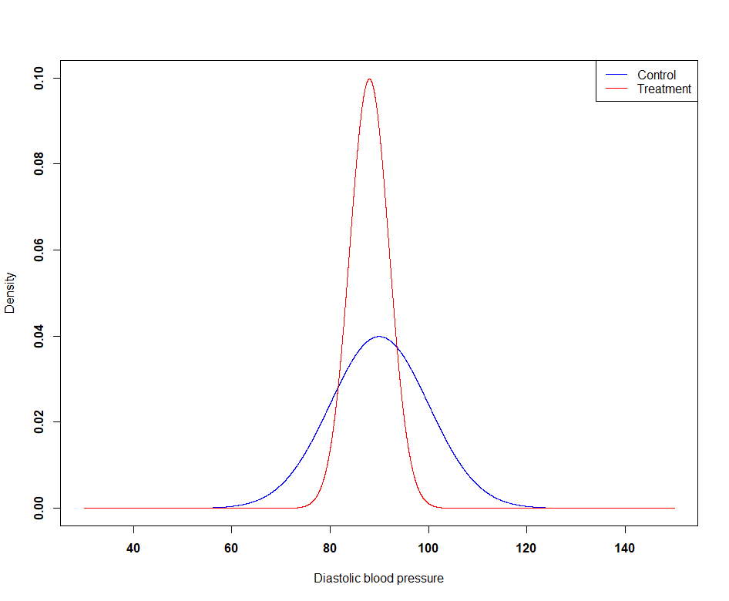
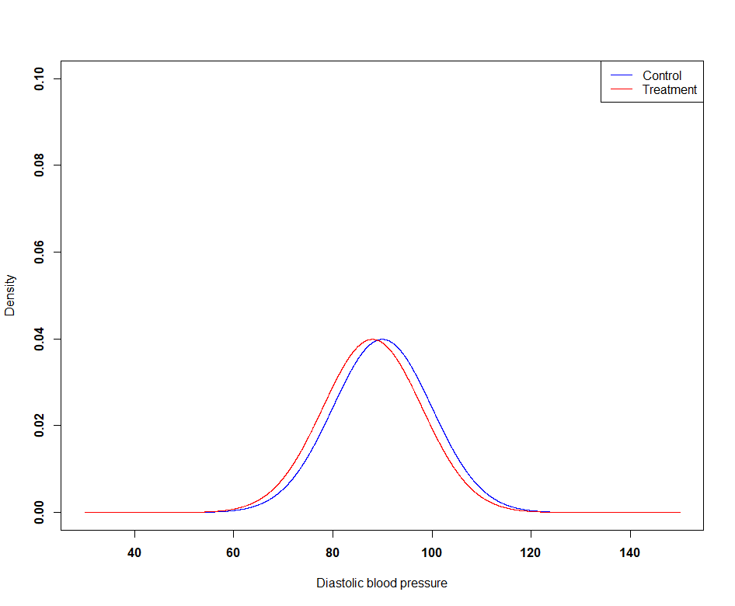
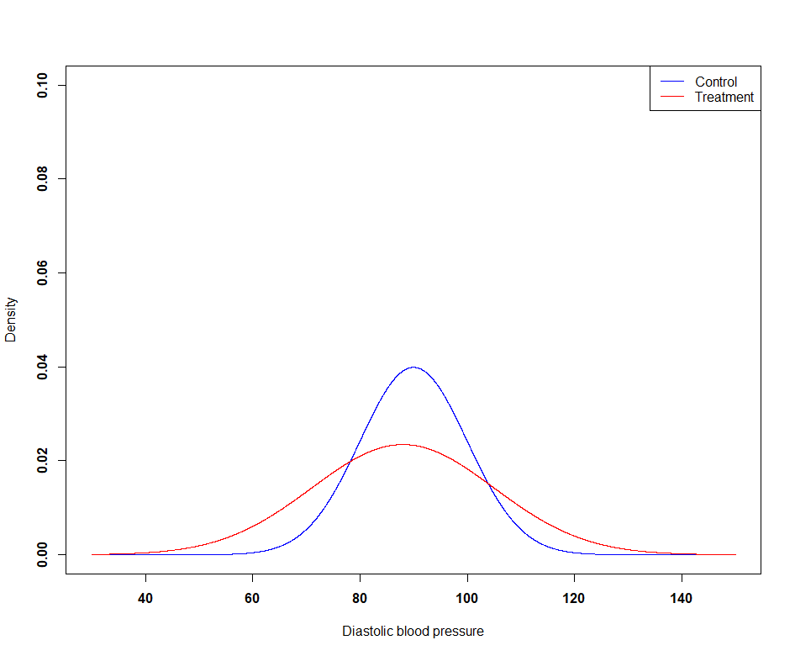

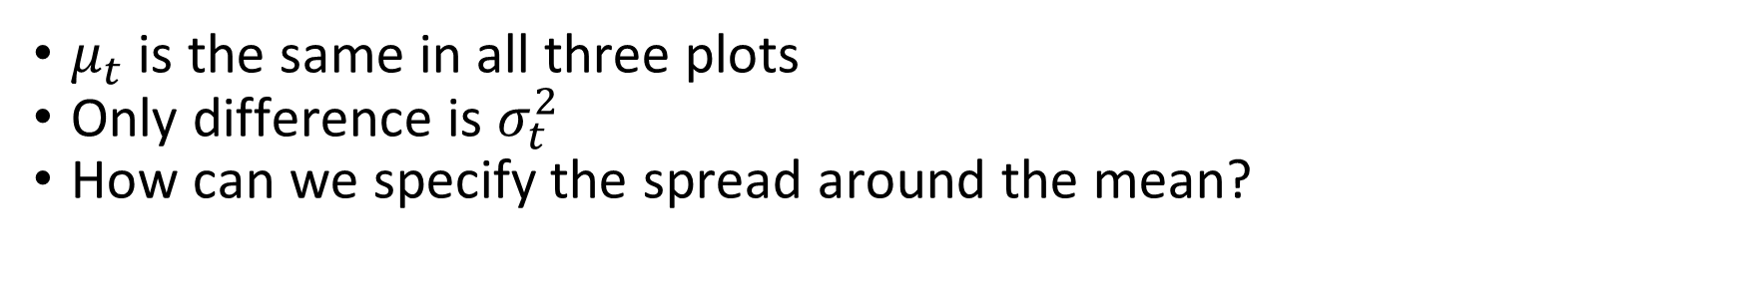


Why does the variance matter? (1/2)
$$Control∼N\left(90, {10}^{2}\right), Treatment∼N\left(88, 4^{2}\right)$$
$$Control∼N\left(90, {10}^{2}\right), Treatment∼N\left(88, {10}^{2}\right)$$
$$Control∼N\left(90, {10}^{2}\right), Treatment∼N\left(88, {17}^{2}\right)$$
$μ_{t}$ is the same in all three plots
Only difference is $σ_{t}^{2}$
How can we specify the spread around the mean?
Slide 8
Notes:
Treatment
Sd = 4
Sd = 10
Sd = 17
Control
Sd = 10

Slide 10
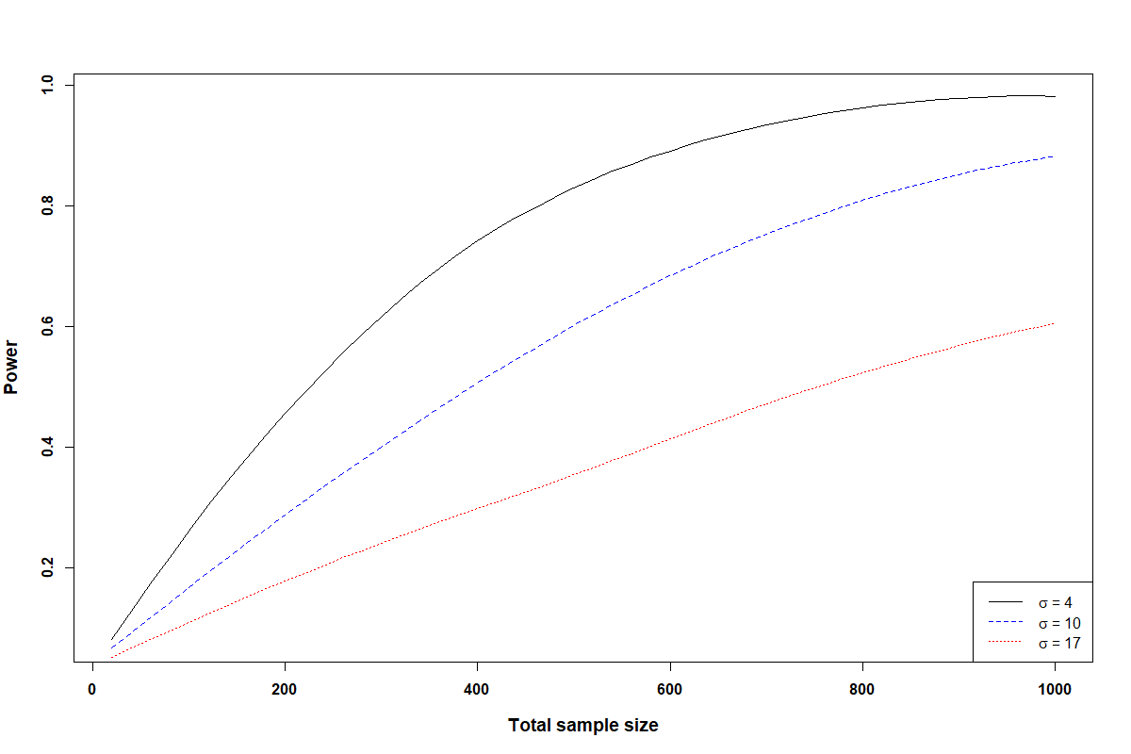
Why does the variance matter? (2/2)
Slide 9
Notes:
Treatment
Sd = 4
Sd = 10
Sd = 17
Control
Sd = 10

Slide 11
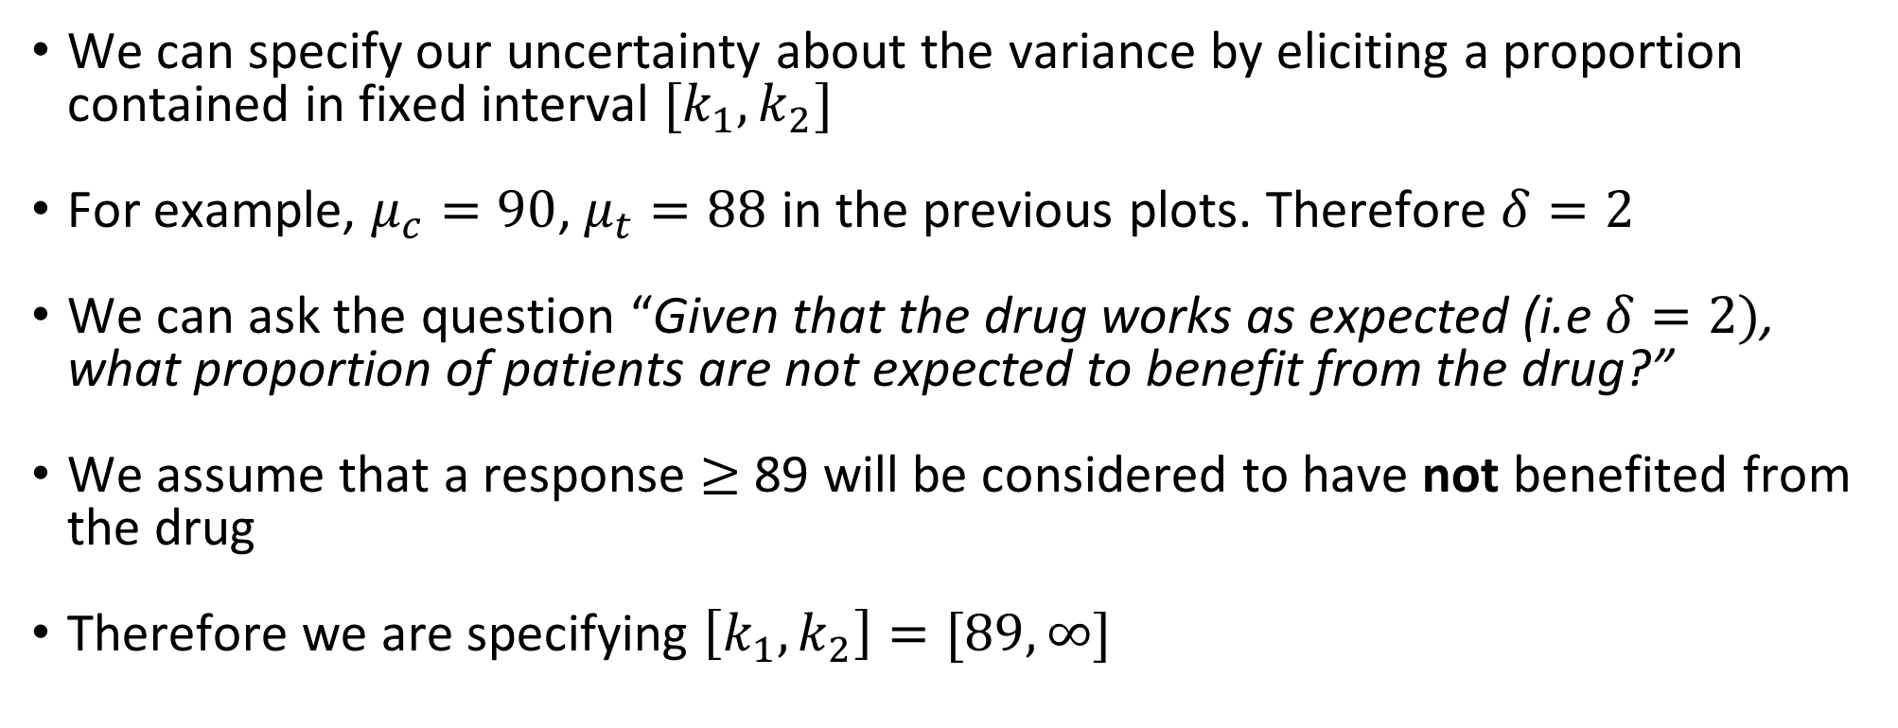
Choosing the interval
We can specify our uncertainty about the variance by eliciting a proportion contained in fixed interval $[k_{1}, k_{2}]$
For example, $μ_{c}=90$, $μ_{t}=88$ in the previous plots. Therefore $δ=2$
We can ask the question “Given that the drug works as expected (i.e $δ=2)$, what proportion of patients are not expected to benefit from the drug?”
We assume that a response $≥$ 89 will be considered to have not benefited from the drug
Therefore we are specifying $\left[k_{1}, k_{2}\right]=[89, ∞]$
Slide 10

Slide 12
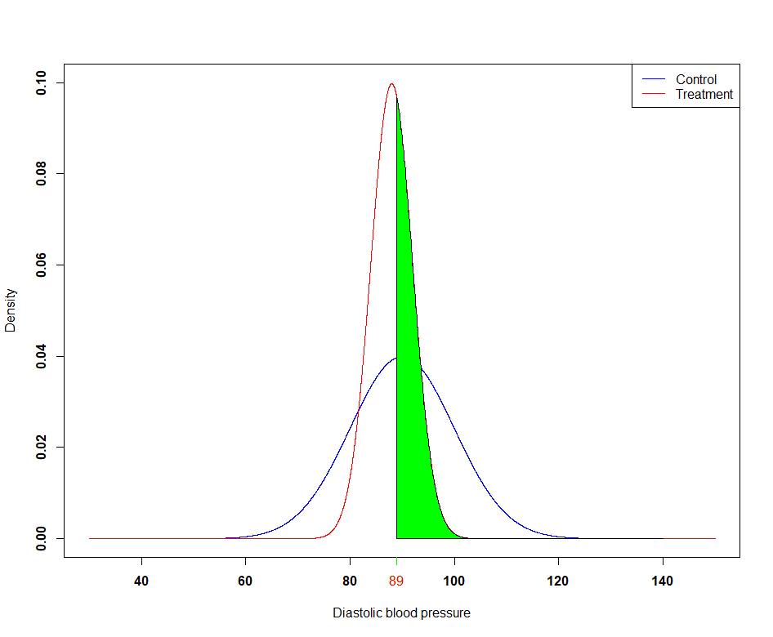
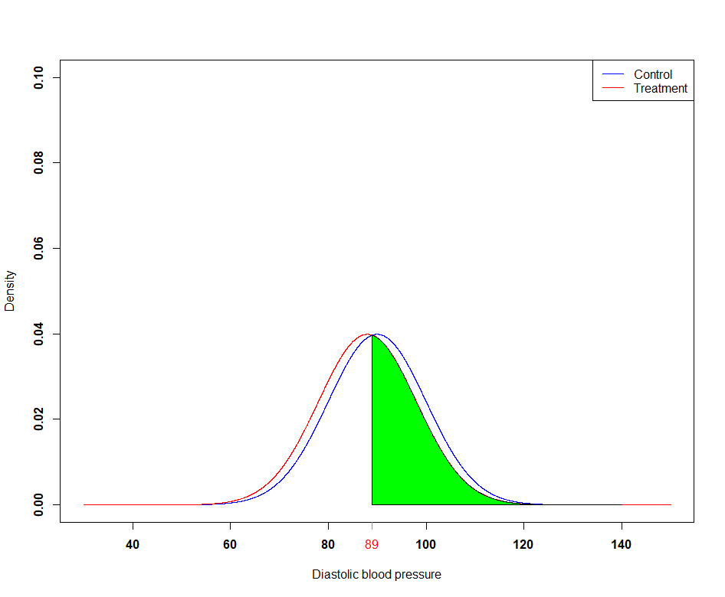
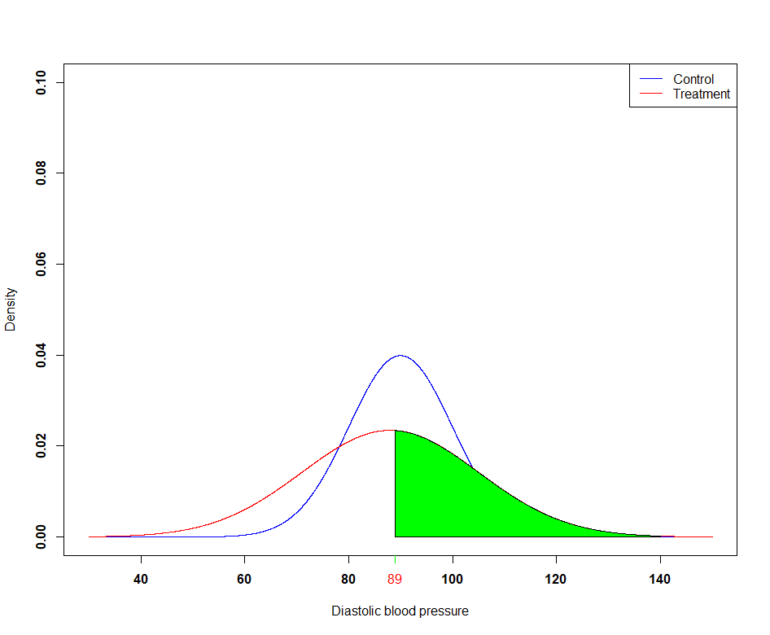



What this interval corresponds to
$$Control∼N\left(90, {10}^{2}\right), Treatment∼N\left(88, 4^{2}\right)$$
$$Control∼N\left(90, {10}^{2}\right), Treatment∼N\left(88, {10}^{2}\right)$$
$$Control∼N\left(90, {10}^{2}\right), Treatment∼N\left(88, {17}^{2}\right)$$
40% of patients in Green Region
46% of patients in Green Region
48% of patients in Green Region
Slide 11
Notes:
The choice of $σ_{t}^{2}$ impacts the area of this region
0.40 in Figure 1
0.46 in Figure 2
0.48 in Figure 3

Slide 13
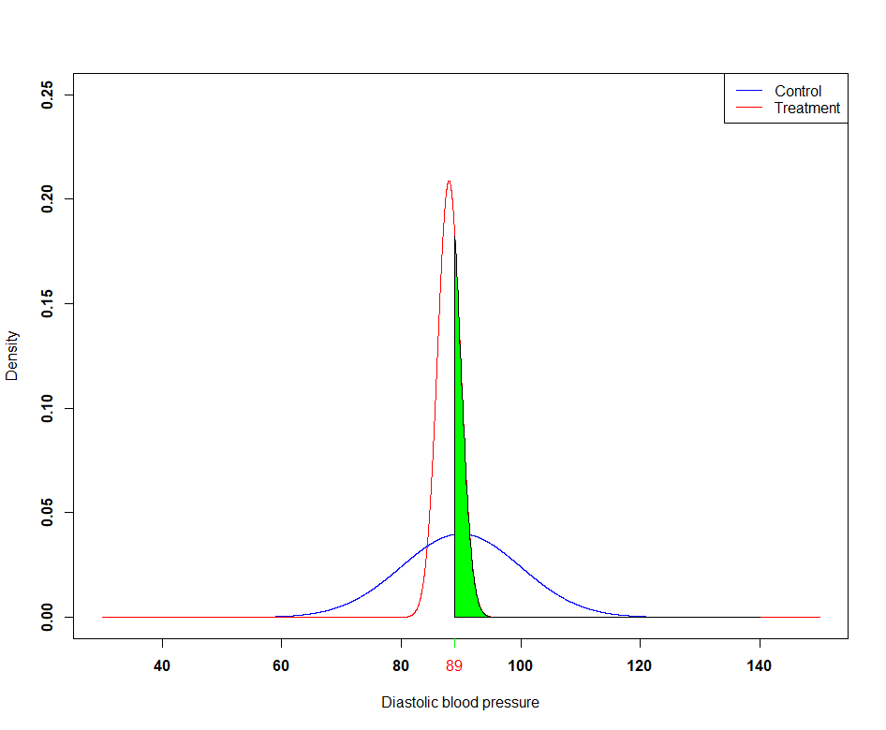
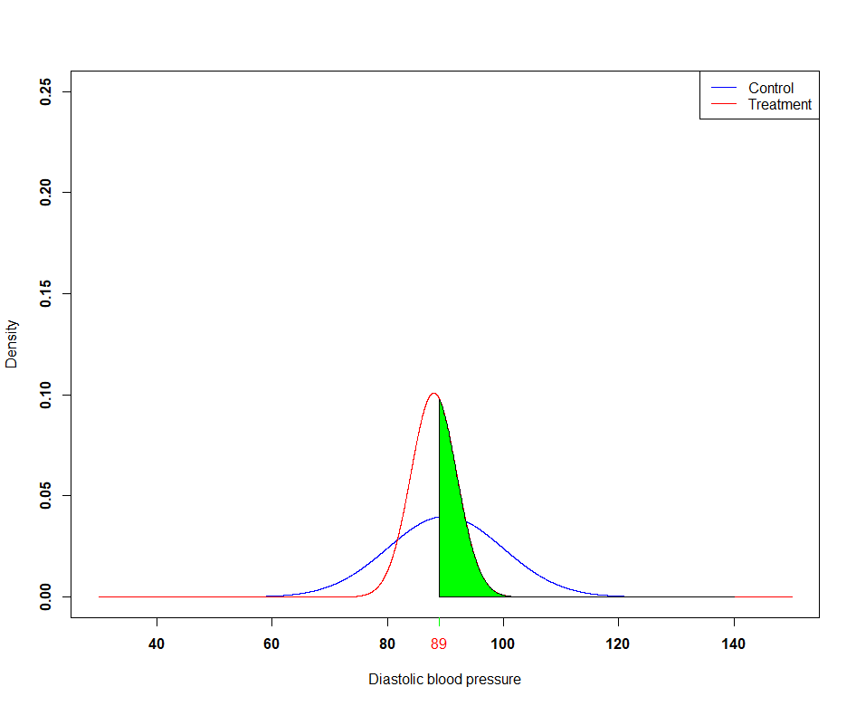

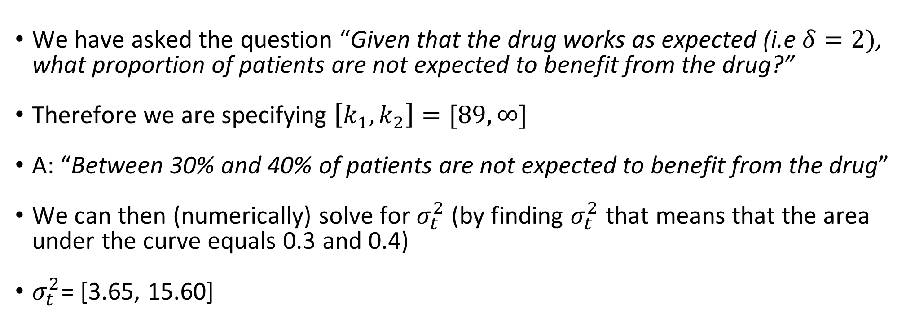
Eliciting $σ_{t}^{2}$
We have asked the question “Given that the drug works as expected (i.e $δ=2)$, what proportion of patients are not expected to benefit from the drug?”
Therefore we are specifying $\left[k_{1}, k_{2}\right]=[89, ∞]$
A: “Between 30% and 40% of patients are not expected to benefit from the drug”
We can then (numerically) solve for $σ_{t}^{2}$ (by finding $σ_{t}^{2}$ that means that the area under the curve equals 0.3 and 0.4)
$σ_{t}^{2}$= [3.65, 15.60]
Slide 12

Slide 14
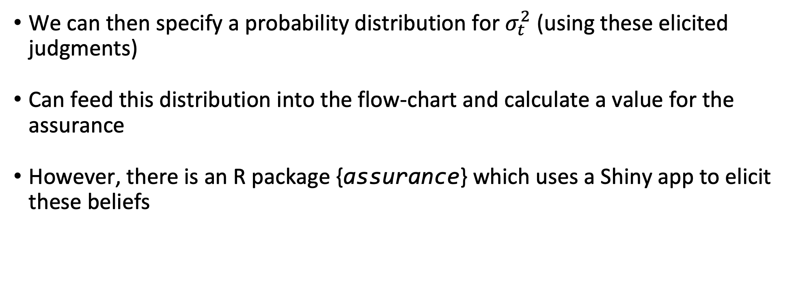
Calculating assurance
We can then specify a probability distribution for $σ_{t}^{2}$ (using these elicited judgments)
Can feed this distribution into the flow-chart and calculate a value for the assurance
However, there is an R package {assurance} which uses a Shiny app to elicit these beliefs
Slide 13

Slide 15
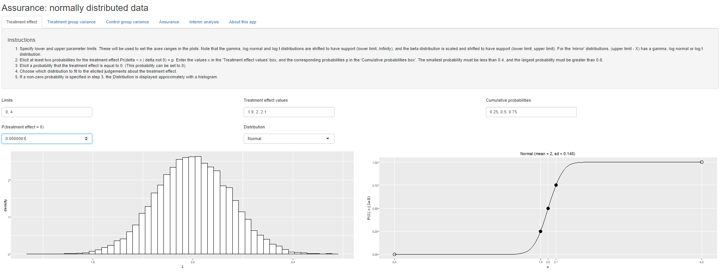
Shiny app (1/3)
Slide 14

Slide 16
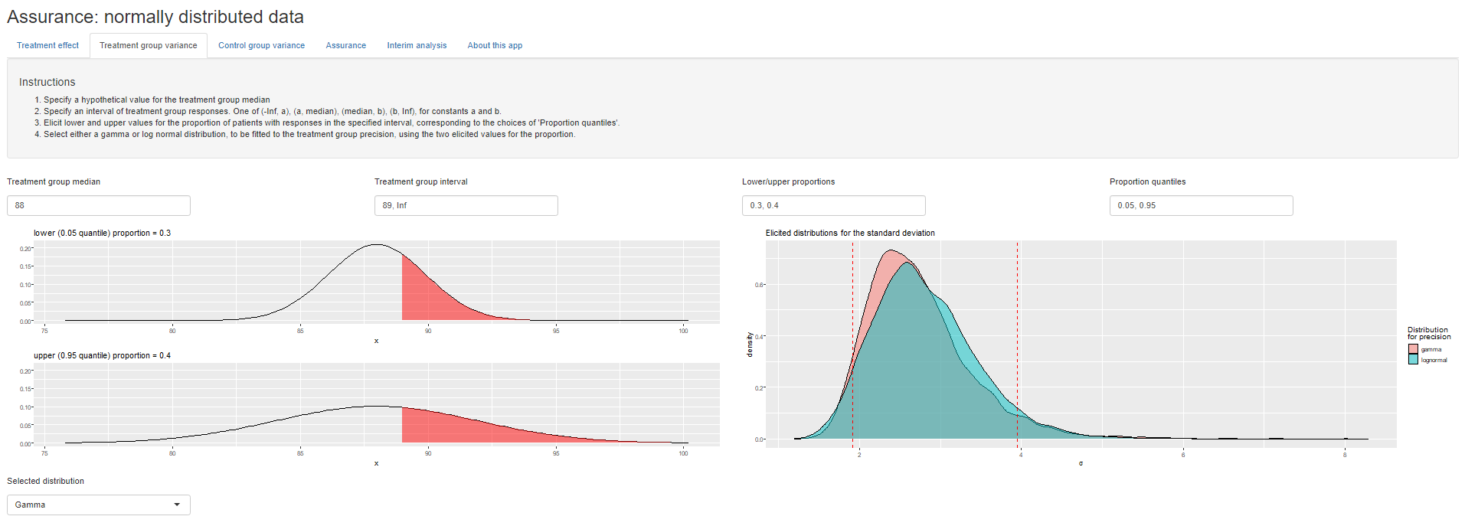
Shiny app (2/3)
Slide 15

Slide 17
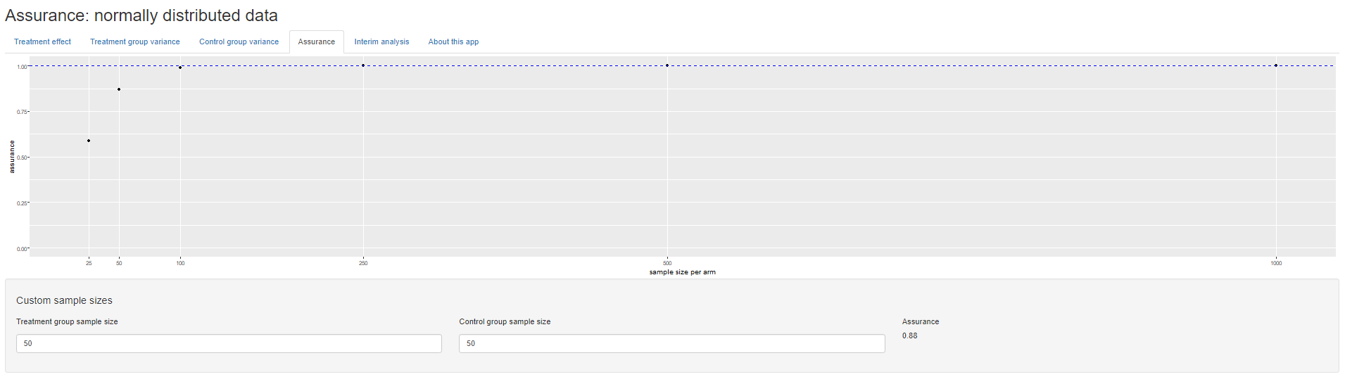
Shiny app (3/3)
Slide 16

Slide 18
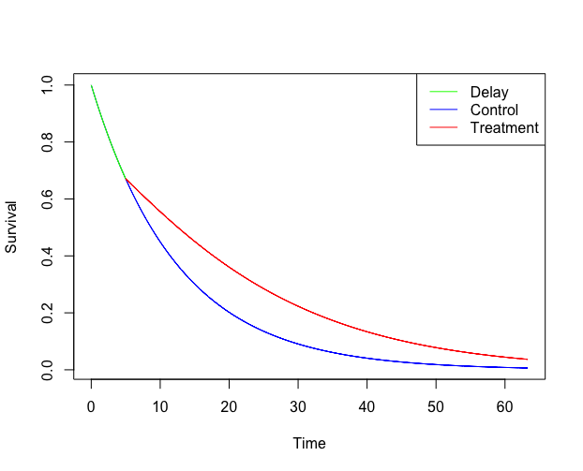
My current research
I have been working in collaboration with Novartis to develop assurance methods for when delayed treatment effects (DTE) are present
DTE exhibits behaviour shown in the following plot:
Slide 17

Slide 19
What makes DTE hard?
In design:
When are the curves going to separate?
When to plan for interim analyses?
In analysis:
Proportional hazards are violated, how do you account for this?
Weighted log-rank test etc, RMST..
Slide 18

Slide 20
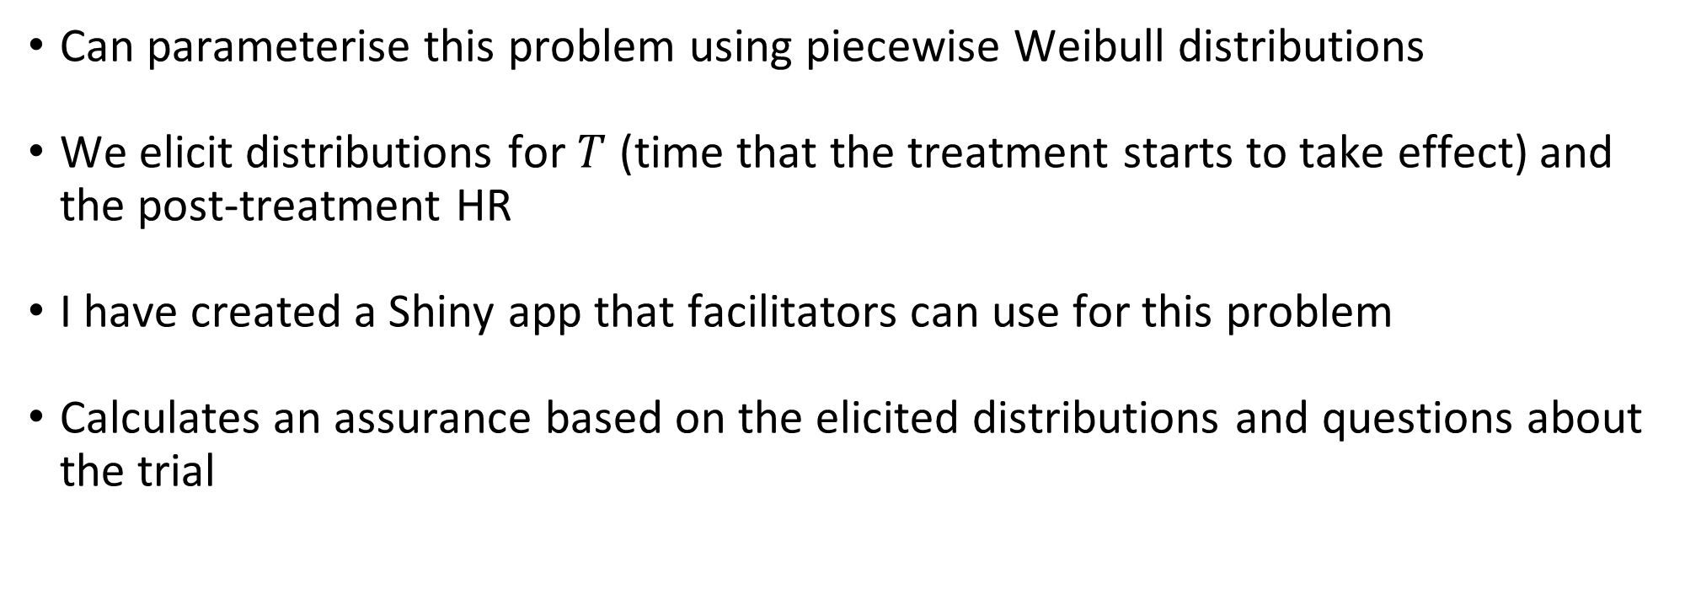
DTE assurance
Can parameterise this problem using piecewise Weibull distributions
We elicit distributions for $T$ (time that the treatment starts to take effect) and the post-treatment HR
I have created a Shiny app that facilitators can use for this problem
Calculates an assurance based on the elicited distributions and questions about the trial
Slide 19

Slide 21
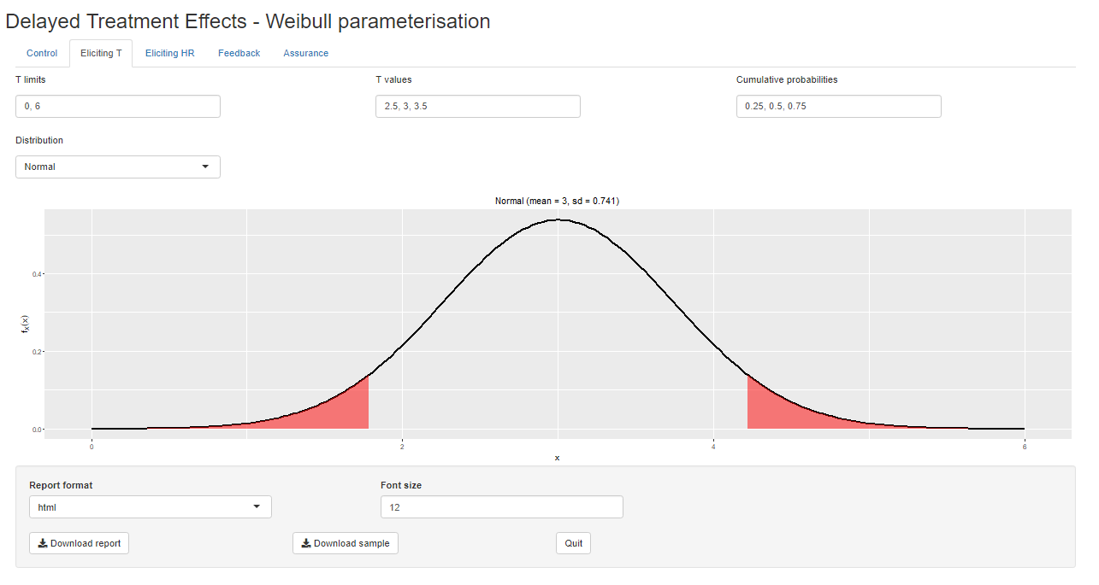
DTE assurance shiny app (1/3)
Slide 20

Slide 22
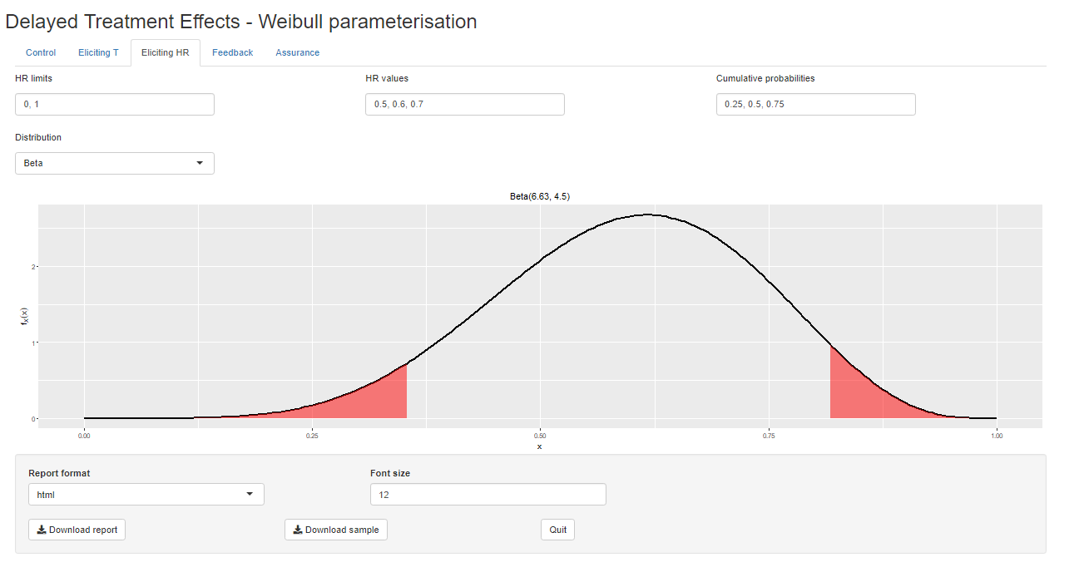
DTE assurance shiny app (2/3)
Slide 21

Slide 23
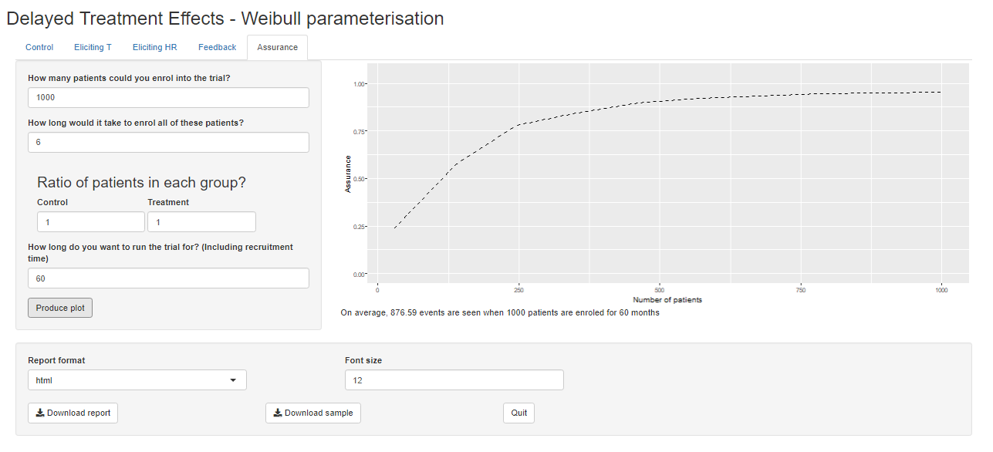
DTE assurance shiny app (3/3)
Slide 22

Slide 24






Thank you! Any questions?
SHELF website
My shiny app!
jsalsbury1@sheffield.ac.uk
jamesalsbury.github.io
james-salsbury

Slide 25
References
O'Hagan, Anthony & Stevens, John & Campbell, Michael. (2005). Assurance in clinical trial design. Pharmaceutical Statistics. 4. 187 - 201. 10.1002/pst.175.
Ren, Shijie & Oakley, Jeremy. (2014). Assurance calculations for planning clinical trials with time-to-event outcomes. Statistics in medicine. 33. 10.1002/sim.5916.
Alhussain, Z. and Oakley, J (2020). Assurance for clinical trial design with normally distributed outcomes: eliciting uncertainty about variances. Pharmaceutical Statistics. 19(6) pp. 827-839.
https://www.psiweb.org/docs/default-source/default-document-library/alessandro-previtali-slides.pdf?sfvrsn=224dedb_0

